Slide 1
Prospects of a opening an Vegan Restaurant in Manhattan

Slide 2
Description of the problem
I have decided to work on the problem on finding the best location to start a new Vegan restaurant in New York

Slide 3
Target audience:
Business personnel who wants to invest or open a Vegan restaurant or any other type of new restaurant in an already crowded New York market. This analysis will be a comprehensive guide to start or expand restaurants targeting the young to middle aged crowd.
Freelancer Chef who loves to have their own restaurant as a side-line.

Slide 4
Data
File containing the neighbourhoods of New York. Neighborhood has a total of 5 boroughs and 306 neighborhoods.
The other type of data is from FourSquare to get the location data of venues in the neighbourhoods.

Slide 5
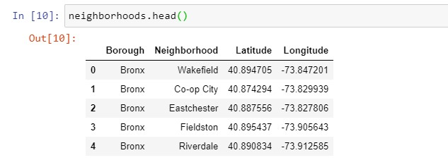
Methodology We will first get all the data into a data frame as shown.

Slide 6
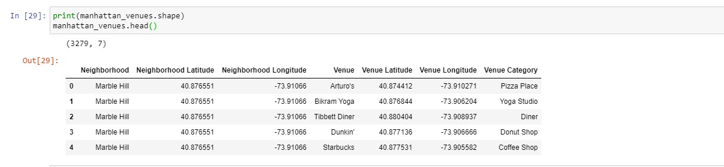
Foursquare Data For this business problem I have used, the FourSquare API to retrieve information about the Venue, Venue category with the longitudes and latitudes

Slide 7
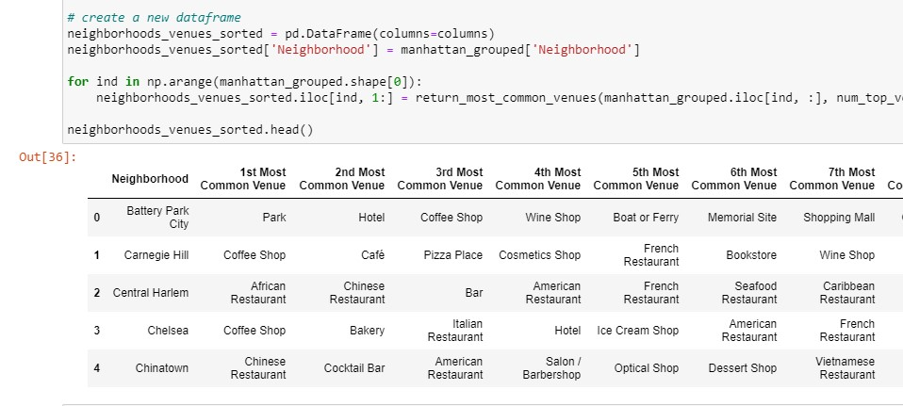
Data Analysis We will do one hot encoding for getting dummies of venue category. Then we will group venue using the groupby using neighborhoods.

Slide 8
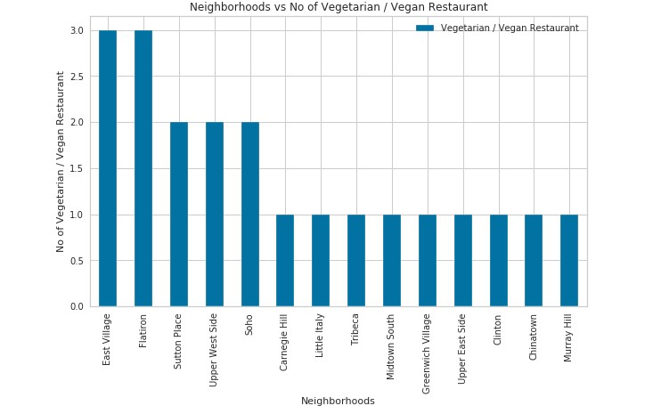
Vegetarian restaurant vs neighbourhoods plot:

Slide 9
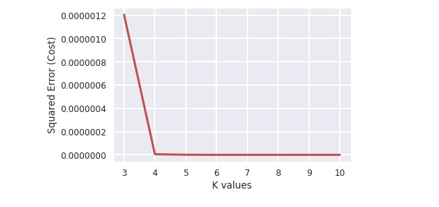
Clustering the Neighborhoods: Best value of k is 4 as shown below

Slide 10
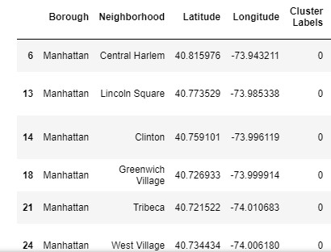
The cluster values are 0, 1, 2 and 3.
For cluster value of 0 the values of Boroughs are as follows.

Slide 11
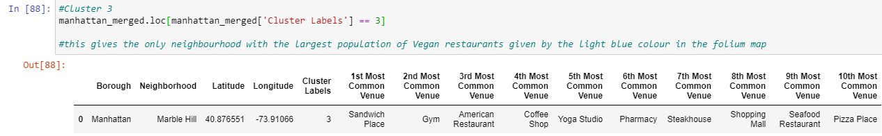
For cluster value of 3 the values of Boroughs are as follows.

Slide 12
Results
We have found out that there are 14 neighbourhoods have already got a least density of Vegan restaurants. they include:
Central Harlem
Lincoln Square
Clinton
Greenwich Village
Tribeca
West Village
Morning Heights
Gramercy
Battery Park City
Financial District
Noho
Civic Centre
Turtle bay
Hudson yards
So it would be a good idea to start in the above areas as they do not have enough Vegan restaurants and it will be a good business investment.

Slide 13
With a cluster value of 3, Marble Hill is the worst neighbourhood to open a new Vegan restaurant as this is already an over saturated area of vegan restaurants.

Slide 14
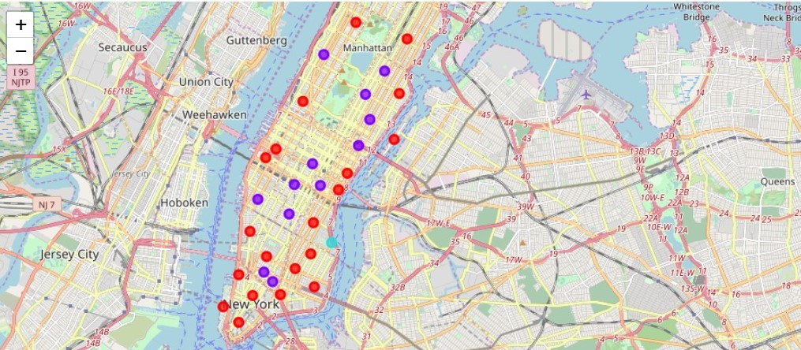
For cluster value of 0 the boroughs are shown as red dots on the above Folium map.
For cluster value of 3 the Borough (Marble Hill) shown as the light blue dot on the above Folium map.

Slide 15
Conclusion
As part of the IBM Data Science Capstone Project, I decided to work on the problem on finding the best location to start a new Vegan restaurant in New York.
Analysis was done on this data to find out which is the best neighbourhood suitable for starting a new vegan restaurant.
The datasets contents were manipulated and visualised using the different methods in Python.
I also applied machine learning technique to predict the output given the data and used Folium to visualize it on a map.
We can then use the same project to analyse the best options for other restaurants and even other type of business establishments like gym, cinema, etc. Hopefully, this project helps as an initial guidance to take head on more complex real-life challenges using data-science

